Slide 1
CLOUD COMPUTING ARCHITECTURE
&
REAL WORLD APPLICATIONS OF CLOUD COMPUTING
Bachelor of Engineering- Computer Science & Engineering
Cloud Computing (CC)(23CS009)
Department of Computer Science & Engineering
Chitkara University Institute of Engineering and Technology, Chitkara University, Punjab, India

Slide 2
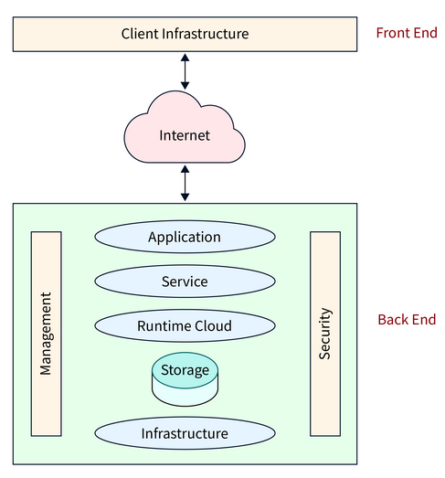
CLOUD COMPUTING ARCHITECTURE
Architecture of cloud computing is the combination of both SOA (Service Oriented Architecture) and EDA (Event Driven Architecture).
Figure: Architecture of cloud computing

Slide 3
CLOUD COMPUTING ARCHITECTURE
Client infrastructure, application, service, runtime cloud, storage, infrastructure, management and security all these are the components of cloud computing architecture. The cloud architecture is divided into 2 parts as follows:
Frontend: Frontend of the cloud architecture refers to the client side of cloud computing system. Means it contains all the user interfaces and applications which are used by the client to access the cloud computing services/resources. For example, use of a web browser to access the cloud platform.
Backend: Backend refers to the cloud itself which is used by the service provider. It contains the resources as well as manages the resources and provides security mechanisms. Along with this, it includes huge storage, virtual applications, virtual machines, traffic control mechanisms, deployment models, etc.

Slide 4
CLOUD COMPUTING ARCHITECTURE
Following are the components of Cloud Computing Architecture
Client Infrastructure: Client Infrastructure is a part of the frontend component. It contains the applications and user interfaces which are required to access the cloud platform. In other words, it provides a GUI( Graphical User Interface ) to interact with the cloud.
Application: Application is a part of the backend component that refers to a software or platform to which the client accesses. Means it provides the service in the backend as per the client’s requirement.
Service: Service in the backend refers to the three major types of cloud-based services like SaaS, PaaS and IaaS. Also manages which type of service the user accesses.

Slide 5
CLOUD COMPUTING ARCHITECTURE
Runtime Cloud: Runtime cloud in backend provides the execution and Runtime platform/environment to the Virtual machine.
Storage: Storage in backend provides flexible and scalable storage service and management of stored data.
Infrastructure: Cloud Infrastructure in backend refers to the hardware and software components of cloud like it includes servers, storage, network devices, virtualization software etc.
Management: Management in backend refers to management of backend components like application, service, runtime cloud, storage, infrastructure, and other security mechanisms etc.
Security: Security in backend refers to implementation of different security mechanisms in the backend for secure cloud resources, systems, files, and infrastructure to end-users.

Slide 6
CLOUD COMPUTING ARCHITECTURE
Internet: Internet connection acts as the medium or a bridge between frontend and backend and establishes the interaction and communication between frontend and backend.
Database: Database in backend refers to provide database for storing structured data, such as SQL and NOSQL databases. Example of Databases services include Amazon RDS, Microsoft Azure SQL database and Google Cloud SQL.
Networking: Networking in backend services that provide networking infrastructure for application in the cloud, such as load balancing, DNS and virtual private networks.
Analytics: Analytics in backend service that provides analytics capabilities for data in the cloud, such as warehousing, business intelligence and machine learning.

Slide 7
REAL WORLD APPLICATIONS OF CLOUD COMPUTING
Cloud computing has revolutionized the way businesses and individuals operate by providing scalable, cost-effective and on-demand computing resources. Here are some real-world applications of cloud computing across various domains:
Healthcare
Electronic Health Records (EHR): Cloud platforms enable secure storage, retrieval, and sharing of patient records among healthcare providers.
Telemedicine: Patients and doctors use cloud-based platforms for virtual consultations, making healthcare more accessible.
Medical Research: Cloud computing supports large-scale data analysis for genomics, drug discovery, and disease research.

Slide 8
REAL WORLD APPLICATIONS OF CLOUD COMPUTING
2. Education
E-Learning Platforms: Services like Google Classroom, Zoom, and Coursera use cloud computing to deliver courses and manage content.
Collaborative Tools: Students and teachers collaborate using cloud-based tools like Google Docs and Microsoft Teams.
Data Management: Schools and universities store student records, grades and schedules securely in the cloud.
3. Entertainment and Media
Streaming Services: Platforms like Netflix, Spotify, and YouTube use cloud infrastructure to stream content to millions of users worldwide.
Gaming: Cloud gaming services like Xbox Cloud Gaming and NVIDIA GeForce NOW allow users to play high-quality games without expensive hardware.
Content Delivery: Media companies use cloud-based Content Delivery Networks (CDNs) to ensure faster and more reliable content distribution.

Slide 9
REAL WORLD APPLICATIONS OF CLOUD COMPUTING
4. Business and Enterprise
Customer Relationship Management (CRM): Tools like Salesforce use the cloud for managing customer data and improving sales.
Enterprise Resource Planning (ERP): Cloud-based ERP systems like SAP and Oracle streamline business operations across departments.
Collaboration and Productivity: Platforms like Slack, Microsoft Office 365, and Google Workspace facilitate team collaboration and task management.
5. Finance
Online Banking: Banks use cloud computing for secure transactions, fraud detection, and real-time data analysis.
Financial Analytics: Cloud-based platforms analyze large datasets to predict market trends and assist in investment decisions.
Payment Gateways: Services like PayPal and Stripe rely on cloud infrastructure for processing millions of transactions.

Slide 10
REAL WORLD APPLICATIONS OF CLOUD COMPUTING
6. Retail and E-Commerce
Online Stores: Platforms like Amazon, Shopify, and eBay use cloud computing for hosting, scaling, and managing inventory.
Personalized Shopping Experiences: AI-driven recommendations powered by cloud computing improve customer engagement.
Supply Chain Management: Retailers use cloud platforms for real-time tracking of inventory and logistics.
7. Government
E-Governance: Governments use cloud-based systems for online tax filing, license applications, and public records management.
Disaster Recovery: Cloud solutions enable governments to ensure data redundancy and recover from disasters quickly.
Smart Cities: IoT devices in smart cities use cloud platforms for managing traffic, utilities, and public services.

Slide 11
REAL WORLD APPLICATIONS OF CLOUD COMPUTING
8. Startups and Developers
Application Development: Startups leverage cloud platforms like AWS, Google Cloud, and Azure to build, test, and deploy applications.
Cost Optimization: Pay-as-you-go pricing models help startups scale without large upfront investments.
APIs and Microservices: Developers use cloud services to integrate APIs and develop microservices for modular applications.
9. Science and Research
Big Data Analysis: Cloud computing enables researchers to process and analyze massive datasets.
Climate Modeling: Scientists use cloud platforms to run simulations and analyze environmental data.
Space Exploration: NASA and other space agencies leverage cloud infrastructure for managing mission data and simulations.

Slide 12
REAL WORLD APPLICATIONS OF CLOUD COMPUTING
10. Personal Use
File Storage and Sharing: Services like Google Drive, Dropbox, and iCloud allow individuals to store and share files easily.
Photo and Video Backup: Cloud services ensure secure storage of personal photos and videos.
Home Automation: Cloud-based IoT platforms control smart devices in homes, like lighting, thermostats, and security cameras.

Slide 13
THANK YOU

